Slide 1
A Novel Random Access for Fixed-Location Machine-to-Machine Communications in OFDMA Based Systems (Kab Seok Ko, Min Jeong Kim, Kuk Yeol Bae, Dan Keun Sung, Jae Heung Kim, and Jae Young Ahn)
Manya Venissa Adzo Sedem
Hanbat National University
ICIS Lab
7th January 2022

Slide 2
Contents
Introduction
Random Access in OFDMA – based system
Proposed Random Access Scheme
Numerical Results
Conclusion

Slide 3
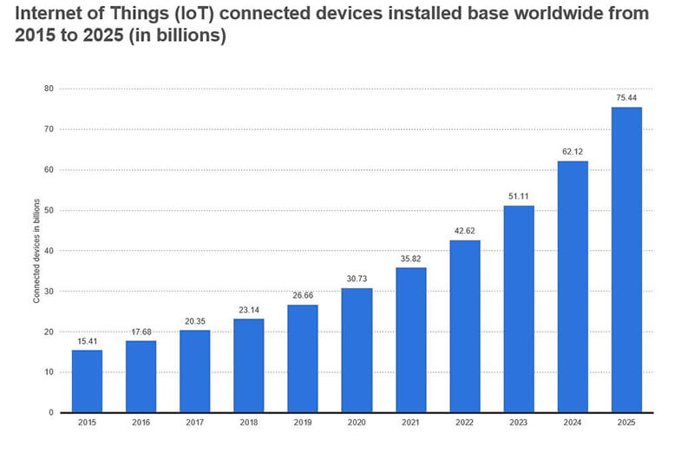
Introduction
Machine-to-machine (M2M) communications are characterized by large number of devices, low data rates, small-sized packets and low or no mobility.
All these devices require access for communication but due to the large numbers, there is contention for resources. This brings about the issue of collision.
In order to support M2M communication in future cellular systems, the collision problem in random access because of access attempts from devices must be resolved.

Slide 4
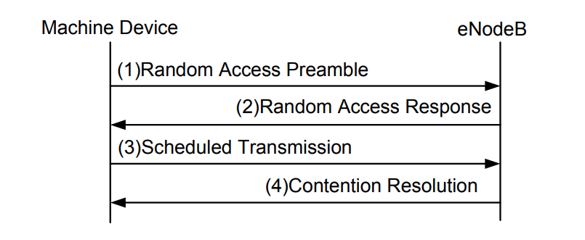

Random Access in OFDMA-based System
During the step 1 of the RA procedure, if more than one device simultaneously transmit the same preamble on the same RA slot, they would receive the same uplink grant and timing alignment information in step 2 and transmit their scheduled messages on the same uplink resource in step 3.
The above results in a collision between these devices.
The probability that a given device selecting one preamble among M preambles experiences a collision with other device(s) among (k-1) devices on a single RA slot is expressed as:
An increase in the number of machine devices causes an increase in the collision probability
Fig 1. Random access procedure in LTE system

Slide 5
Proposed Random Access Scheme
The main objective of this paper is to make use of the fixed timing alignment information from the RA procedure to:
reduce collision probability
lower average access delay and
achieve higher energy efficiency
This is to support M2M communications for a very large number of fixed- location machine devices in future orthogonal frequency division multiple access (OFDMA) systems.

Slide 6
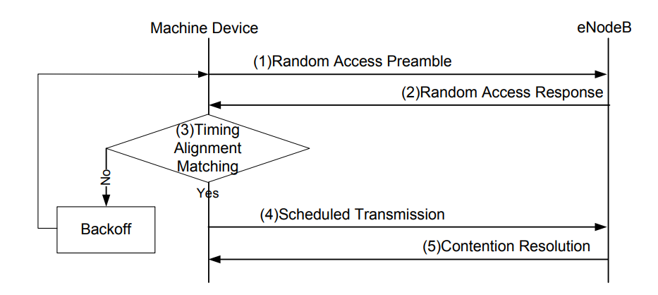
Proposed Random Access Scheme
Conventional RA procedure
Fig 2. Proposed RA procedure
Assumption
Fixed-location machine devices do not utilize the unchanged, fixed TA information during the RA procedure.
Assumption
The TA value between each fixed-location machine device and eNodeB is fixed and unchanged.

Slide 7


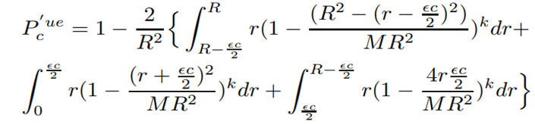
Proposed Random Access Scheme
Timing alignment Matching
Due to measurement or estimation errors at eNodeB for every RA procedure, each fixed-location machine device needs a TA matching mechanism in the proposed scheme.
If we let ϵ be the margin of TA error, the TA matching results are expressed as follows:
As the value of epsilon becomes larger, more machine devices are likely to belong to the acceptable TA range. However, it may increase collision probability.
Suppose k+1 machine devices including one tagged device select their own preambles and attempt RA on a single RA slot.
If the tagged machine device is located according to an f(r) distribution(pdf that there exists a fixed-location machine device at distance (r, r+dr) ), the collision probability is given as:
In the proposed scheme, a tagged machine device experiences collision when at least one of other machine devices located in (r-ϵc/2, r+ϵc/2) selects the same preamble as the tagged device on the same RA slot. The collision probability for the uniformly distributed case is expressed as:

Slide 8
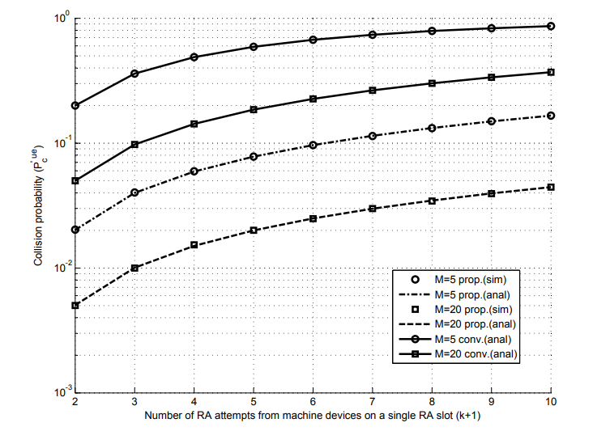
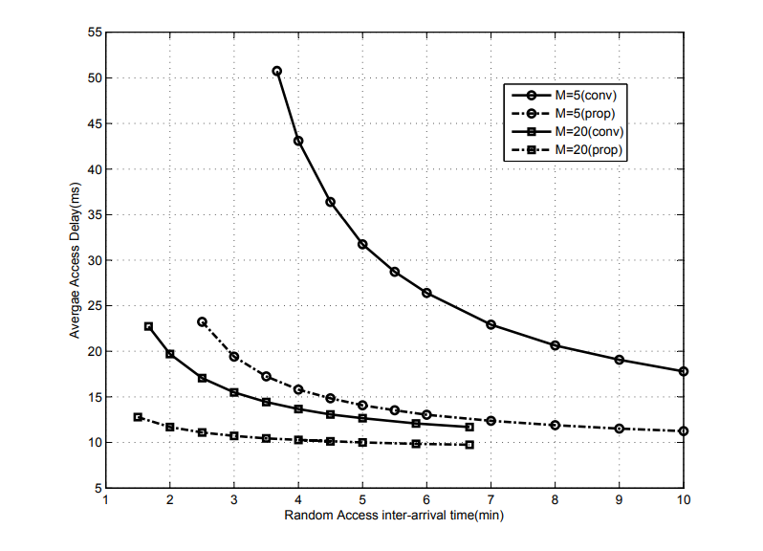
Numerical Results
Fig 3. Collision Probability
Fig 4. Access Delay

Slide 9
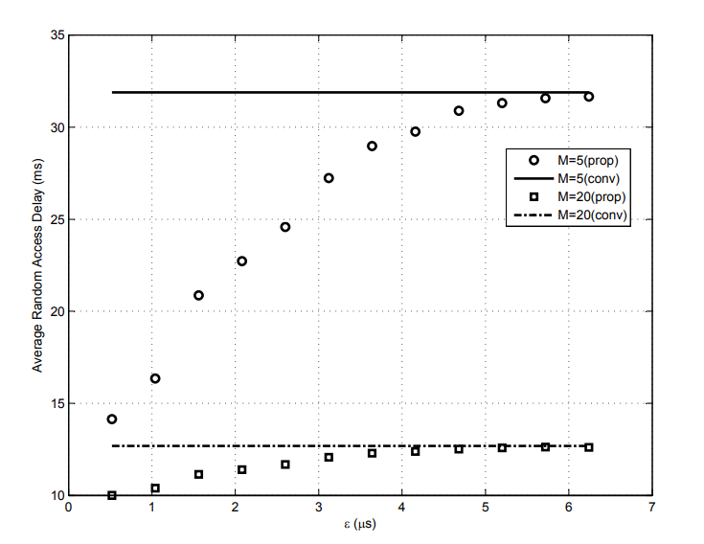
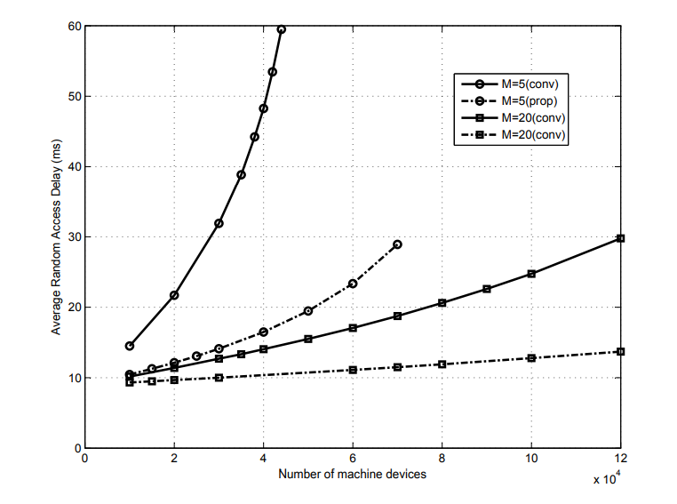
Numerical Results
Fig 6. Impact of ϵ on the access delay of the proposed scheme
Fig 7. Impact of the number of machine devices on the access delay of the proposed scheme and the conventional scheme

Slide 10
Conclusion
A new RA scheme is proposed for fixed-location machine devices utilizing the fact that TA information for these devices is fixed during RA procedure.
The performance of the scheme is evaluated in terms of collision probability, access delay, and the average number of transmissions.
The proposed scheme yields much lower collision probability, shorter access delay, and higher energy efficiency than the conventional one

Slide 11

Any Questions?

